Slide 1
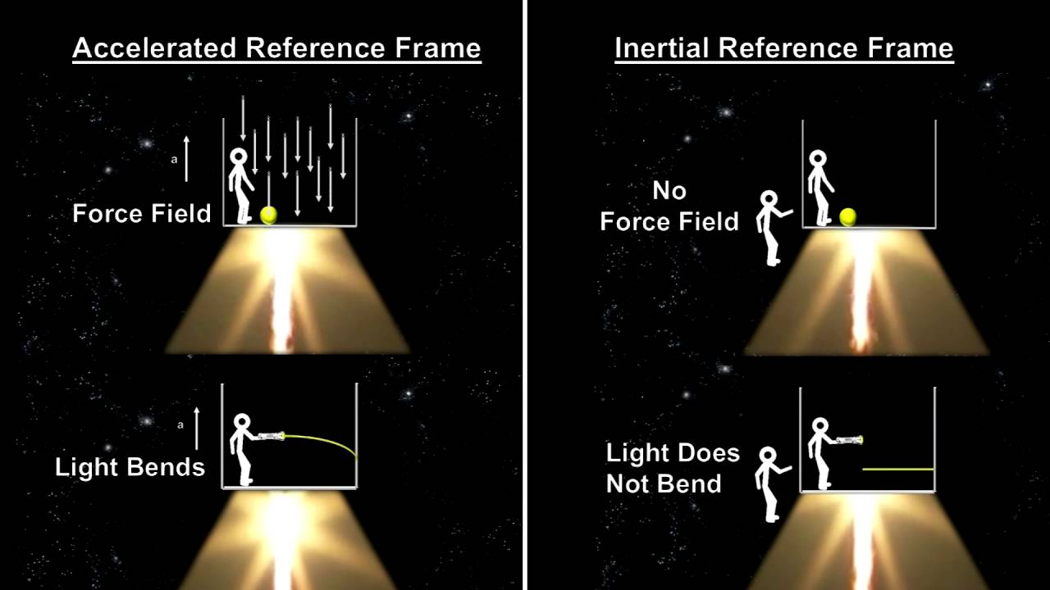
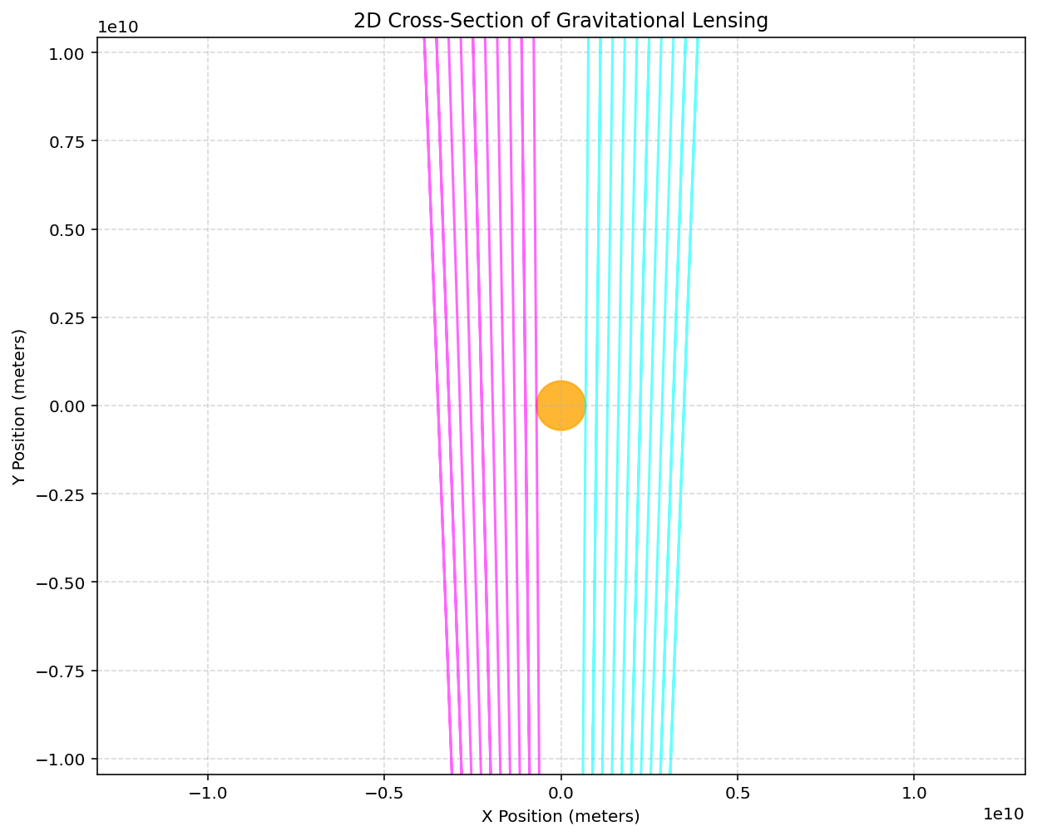
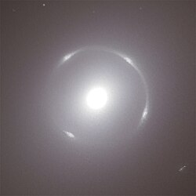
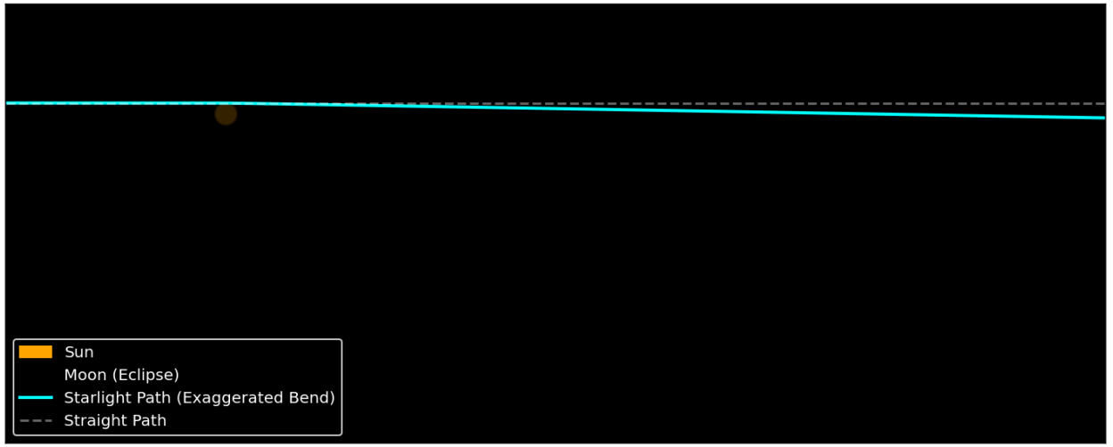
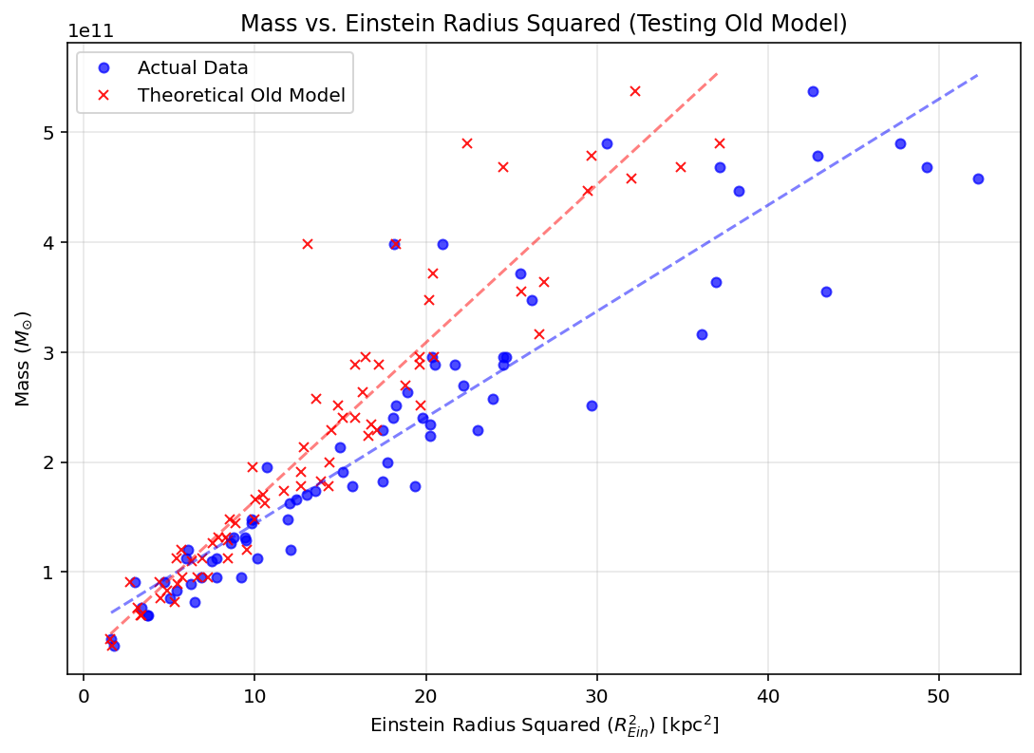
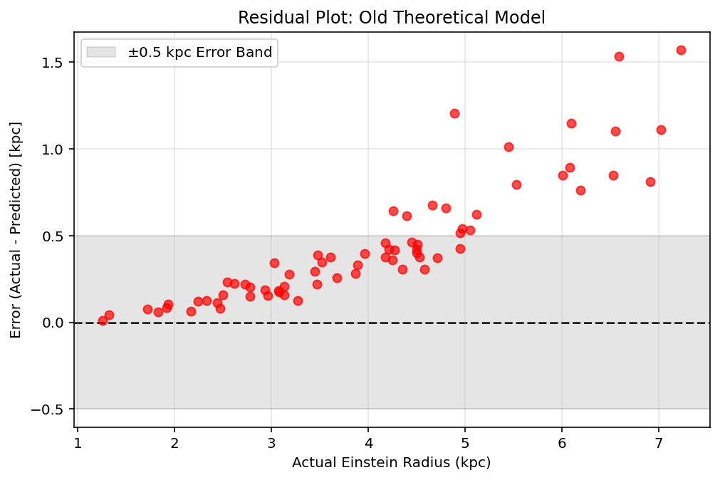
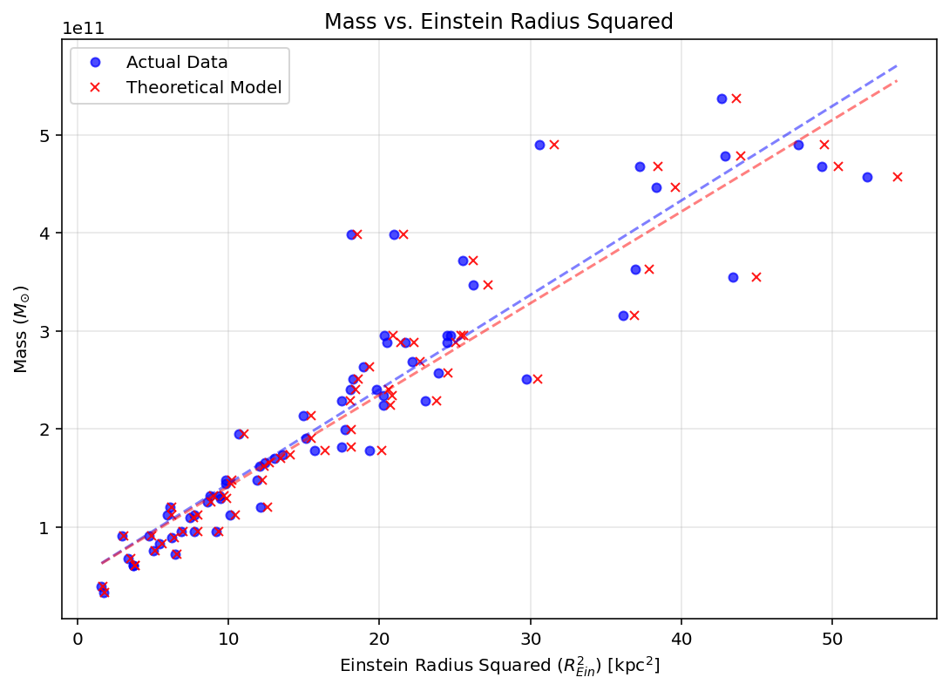
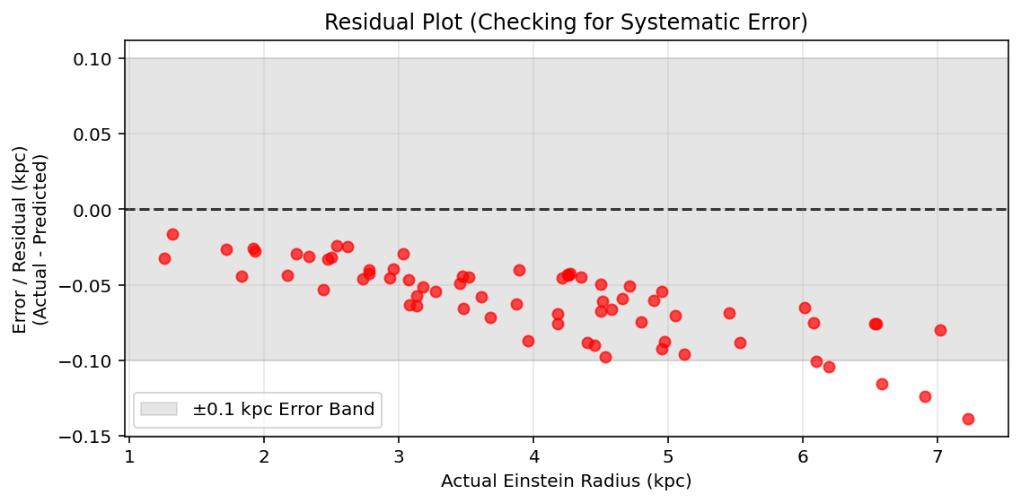
Gravitational Lensing
1. Equivalence Principle
Einstein determined that light bends around large masses, due to gravity. A ring of light can often be seen around large objects, called Einstein rings.
2. Aim
We used this principle to create a computational model for light bending around the Sun, using a geodesic equation, rk4, and by searching for the impact parameter using binary search. We wanted to see the relationship between the ring radius and the object’s mass.
Image of light bending around the sun
Rk4 image?
3. Binary Search
An initial guess is made for a light ray to trace, and binary search essentially halves that guess, and goes higher and lower by a half each time until the light falls into the large object. This is how we were able to find the radius of the Einstein ring. The angle through which the ray is fired and falls into the object, is the angular radius of the Einstein ring.
Image of galaxy, sun, and light rays, using binary search
4. 1.75 arcseconds
In Eddington’s 1919 experiment, during an eclipse, he was able to observe how the light from surrounding stars was bent around the sun, and could be pictured during the eclipse. It was bent by 1.75 arcseconds. This is the value we were looking to achieve with our model, and we did.
5. Extending to all large masses + Failures
After we successfully modelled the Sun, we now wanted to find a general model for all large masses through raytracing. Our initial equation for the model used distances such as Observer→Lens, Observer→Source, Lens→Source. However, DLS did not equal DS-DL. This was due to the expansion of the universe.
There is a clear systematic error
1.75!!!!
This model was not very reliable:
R-Squared: 0.8494 (Closer to 1.0 is better)
MAPE: 9.62% (Average % error)
RMSE: 0.5611 kpc
6. Our Updated Model
Instead of using this model, we used a slightly different one, which ignored the distances and instead used (IDKKKKKKKKKK). This model was compared to the dataset which we had access to, and the model was shown to be reliable, as it was not significantly different to the data.
However, as can be seen here, there is still a very small systematic error in the model, which is causing it to overestimate the radii of the rings.
Our final model was very reliable:
R-Squared: 0.9980 (Closer to 1.0 is better)
MAPE: 1.52% (Average % error)
RMSE: 0.0649 kpc
MAE: 0.0598 kpc

Slide 2
Gravitational Lensing
1. Equivalence Principle
Einstein determined that light bends around large masses, due to gravity. A ring of light can often be seen around large objects, called Einstein rings.
2. Aim
We used this principle to create a computational model for light bending around the Sun, using a geodesic equation, rk4, and by searching for the impact parameter using binary search. We wanted to see the relationship between the ring radius and the object’s mass.
Image of light bending around the sun
Rk4 image?
3. Binary Search
An initial guess is made for a light ray to trace, and binary search essentially halves that guess, and goes higher and lower by a half each time until the light falls into the large object. This is how we were able to find the radius of the Einstein ring. The angle through which the ray is fired and falls into the object, is the angular radius of the Einstein ring.
Image of galaxy, sun, and light rays, using binary search
4. 1.75 arcseconds
In Eddington’s 1919 experiment, during an eclipse, he was able to observe how the light from surrounding stars was bent around the sun, and could be pictured during the eclipse. It was bent by 1.75 arcseconds. This is the value we were looking to achieve with our model, and we did.
5. Extending to all large masses + Failures
After we successfully modelled the Sun, we now wanted to find a general model for all large masses through raytracing. Our initial equation for the model used distances such as Observer→Lens, Observer→Source, Lens→Source. However, DLS did not equal DS-DL. This was due to the expansion of the universe.
There is a clear systematic error
1.75!!!!
This model was not very reliable:
R-Squared: 0.8494 (Closer to 1.0 is better)
MAPE: 9.62% (Average % error)
RMSE: 0.5611 kpc
6. Our Updated Model
Instead of using this model, we used a slightly different one, which ignored the distances and instead used (IDKKKKKKKKKK). This model was compared to the dataset which we had access to, and the model was shown to be reliable, as it was not significantly different to the data.
However, as can be seen here, there is still a very small systematic error in the model, which is causing it to overestimate the radii of the rings.
Our final model was very reliable:
R-Squared: 0.9980 (Closer to 1.0 is better)
MAPE: 1.52% (Average % error)
RMSE: 0.0649 kpc
MAE: 0.0598 kpc

